Slide 1

LinkedIn / Resume Workshop

Slide 2


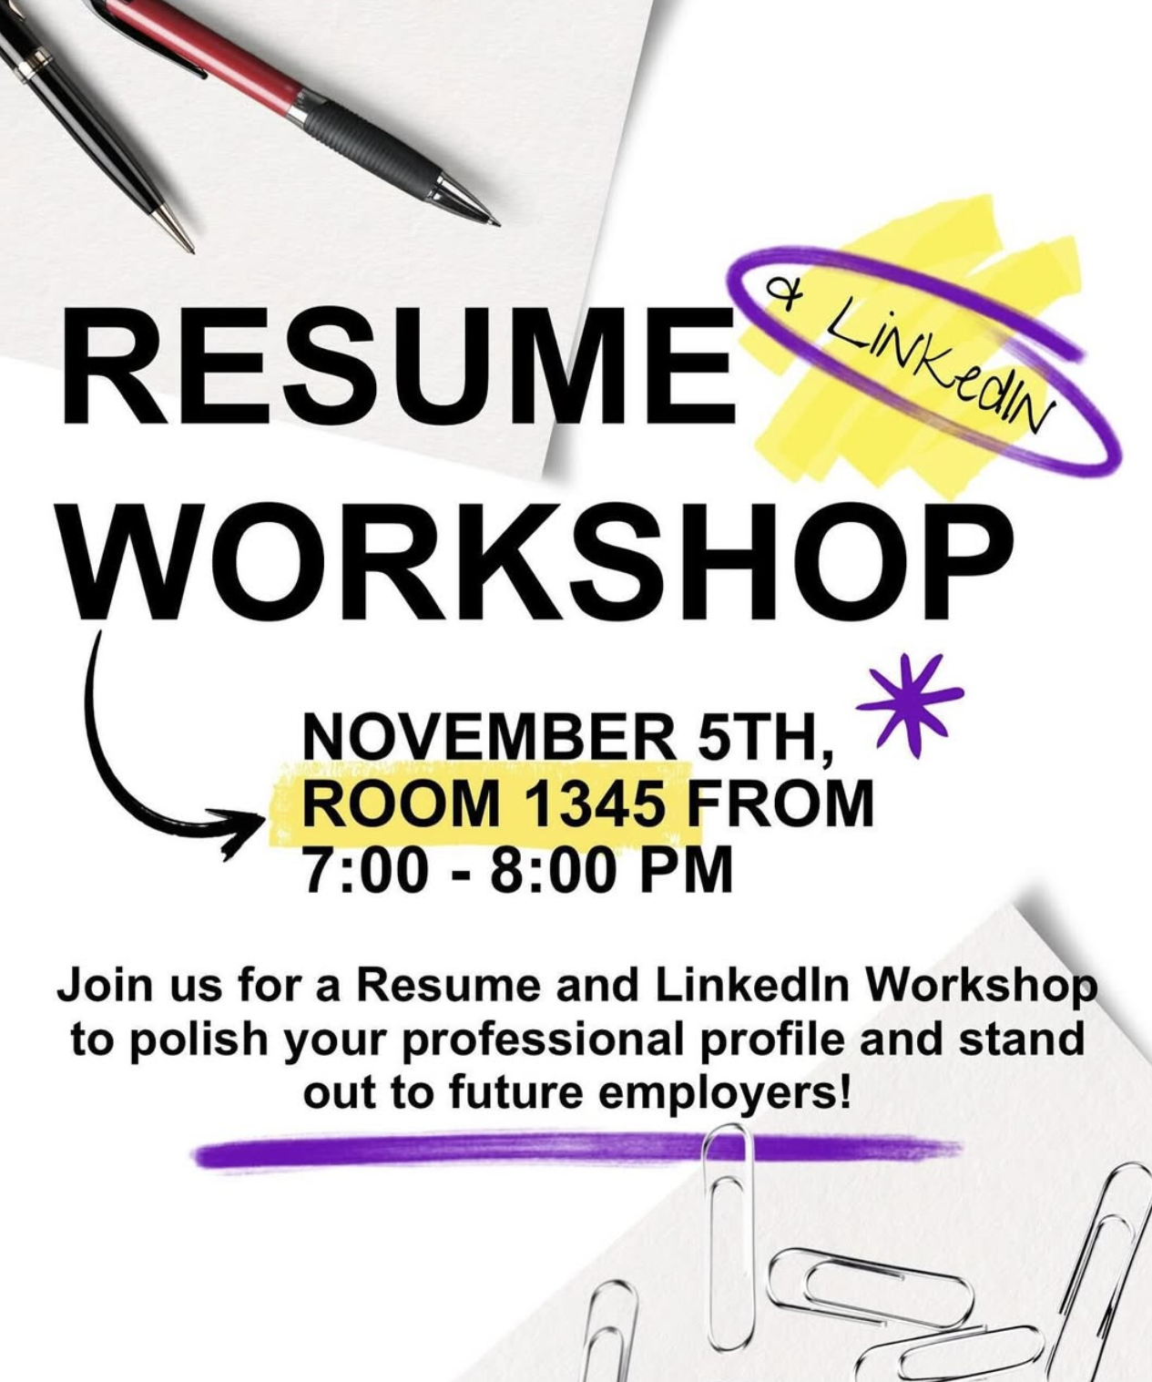


Vice President of Professional Development
Dino Babis | kostandinos.babi@wmich.edu
Education:
Senior
Major: Supply Chain Management
Minor: Business Communications
Associations/Involvements:
SCMA (Supply Chain Management Association)
Men’s Club Soccer
Responsibilities of VPPD are to Help Students With:
Resumes
LinkedIn’s
Interviews
Elevator Pitch

Slide 3

The Backbone of Professional Networking
Professional networking plays an important role throughout your career. If you want to achieve professional success, you need to start networking as soon as possible — and the best way to do so is through LinkedIn…
- Outreach Availability 🌐
- Digital Identity 🧩
- Relationship Builder 🤝
- Career Visibility 🎯

Slide 4
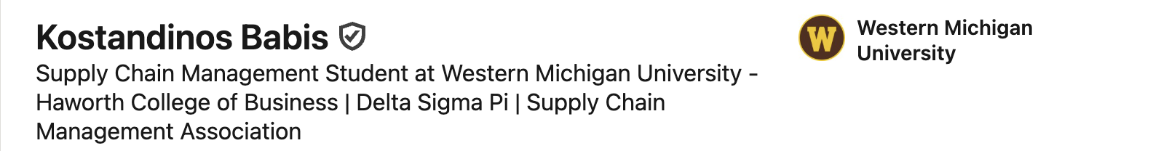
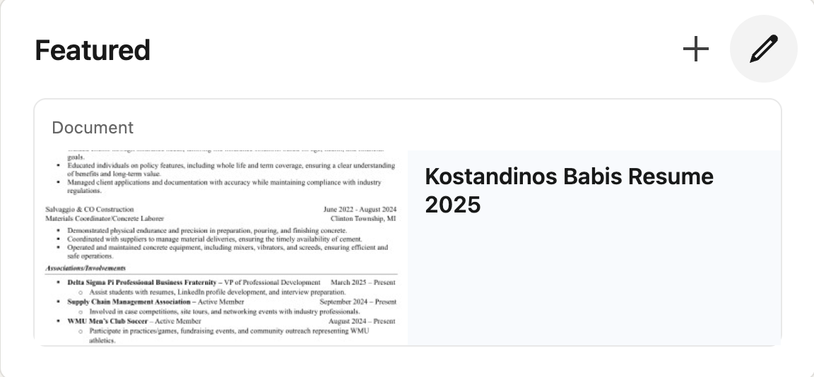
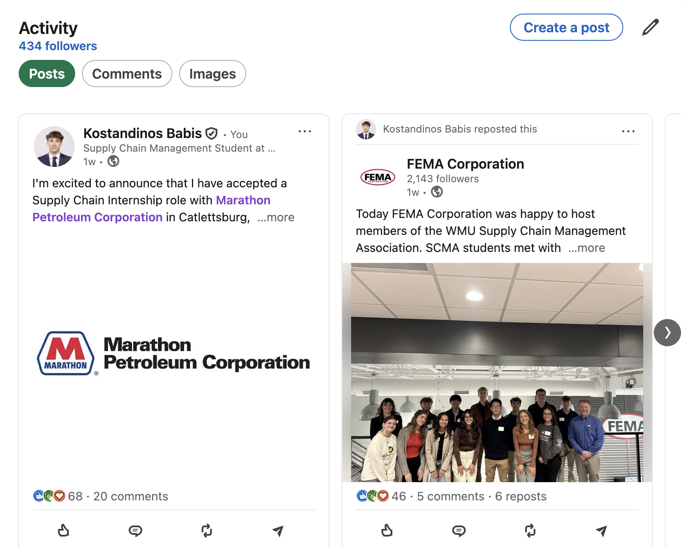
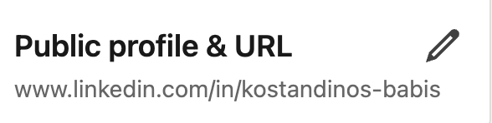
Building a Great Student Profile
Professional Photo:
  No selfies, group photos, hoodies, or t-shirts.
  HCoB holds an event every semester to help with professional photos.
Headline:
  Include your major/minor, school, and involvements.
Featured Section:
  Updated Resume, Cover Letters, or Letter of Recommendation.
Activity Section:
  If you attend any site tours, professional events (this workshop is one of them), or community service.
Customized URL:
  Get rid of any numbers/letters.
  URL should be first-last.

Slide 5
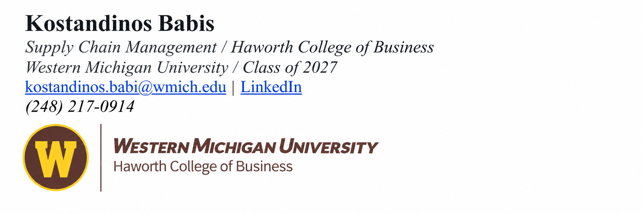
Email Signature

Slide 6
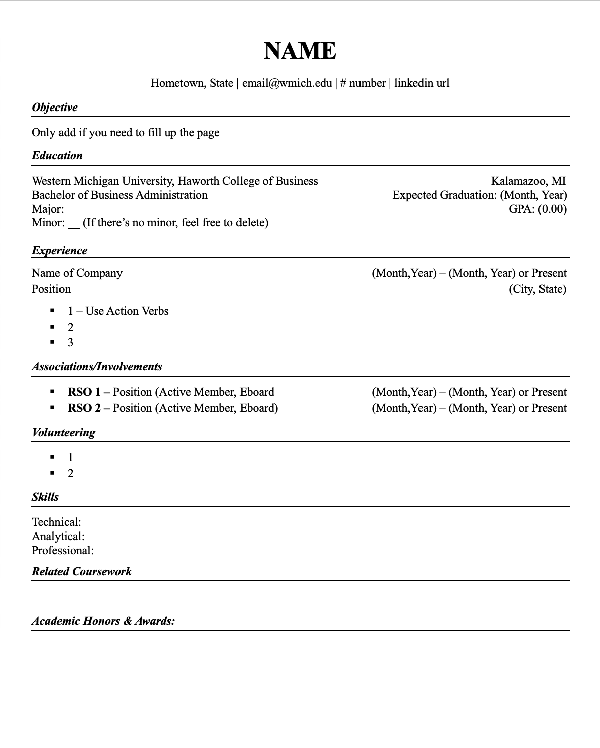
How to Build a Great Resume
Formatting - Consistency is key
- Font: Use the same font across the entire resume (Times New Roman/Arial).
  Employers look for inconsistencies.
- Font Size: Keep between 10-12 pt for body and 14-16 pt for your name.
- Margins: Adjust margins to best suit your resume.
  More content -> Smaller margins.
- Alignment: Left-align text; don’t center unless it’s for your name and contact info.
- Spacing: Use single spacing with a small gap (0-6 pt) between sections for clarity.
- Section Headers: Bold and italicize for visibility; again, consistency is key.
- Length: Keep it to one page.
  Some employers say it’s okay to have more than one. Just keep it to one.

Slide 7
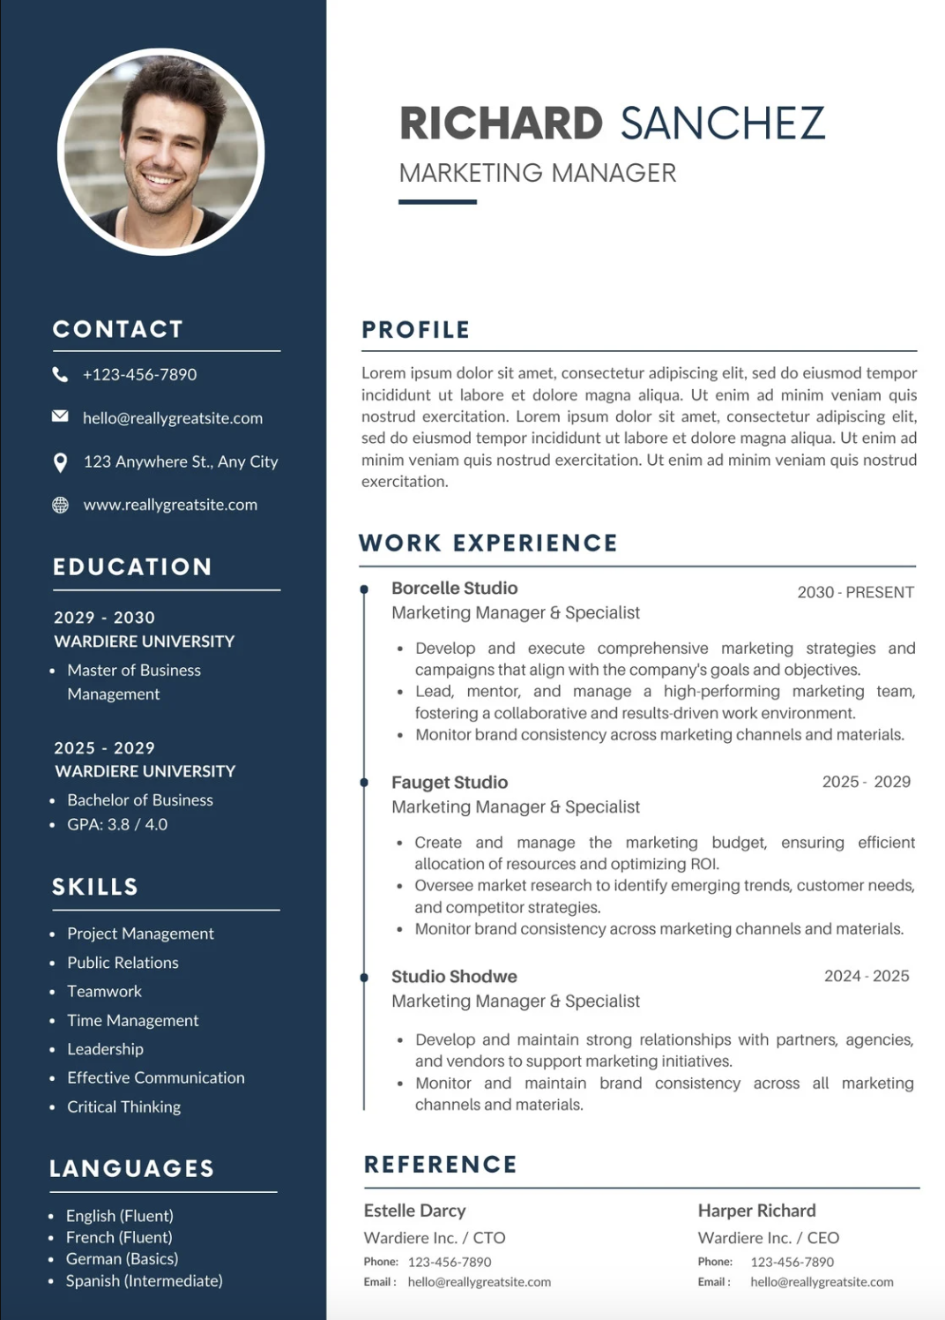
How NOT to Build a Great Resume
- AI: Do not use AI to generate a resume.
- Colors: Don’t use them.
- Page Length: Don’t go over one page.
- Summary: If a summary is used, make sure it’s concise.
- GPA: Don’t round up or lie about your GPA.
- Photo: Don’t include a photo, save that for LinkedIn.

Slide 8
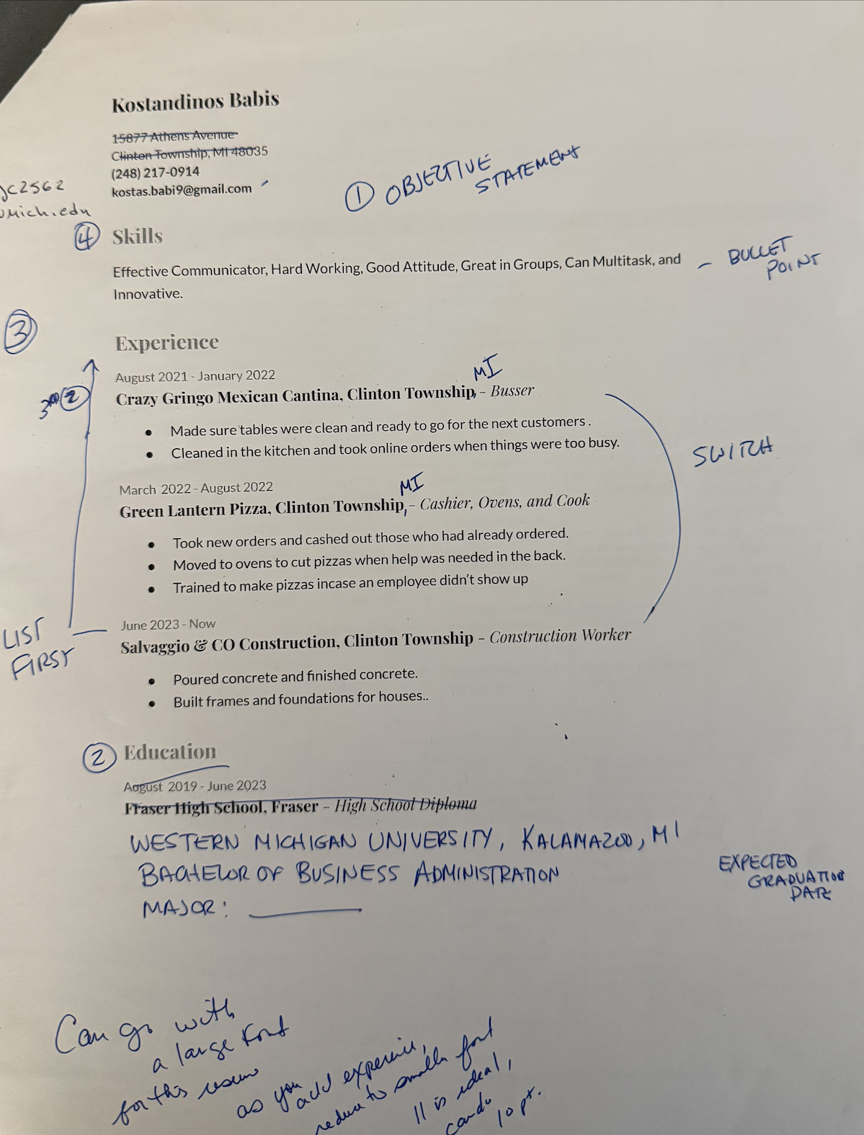
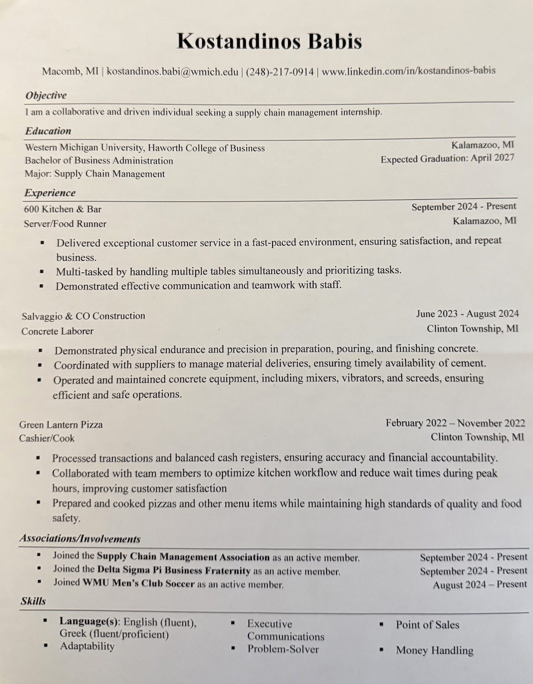
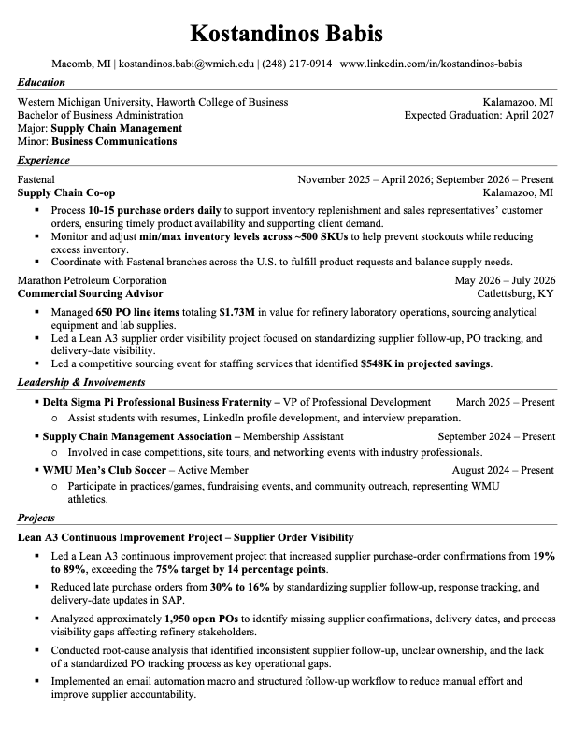
Resume Timeline

Slide 9
Thank You!

